Slide 1

Evolution of global biodiversity
Melanie Tietje

Slide 2
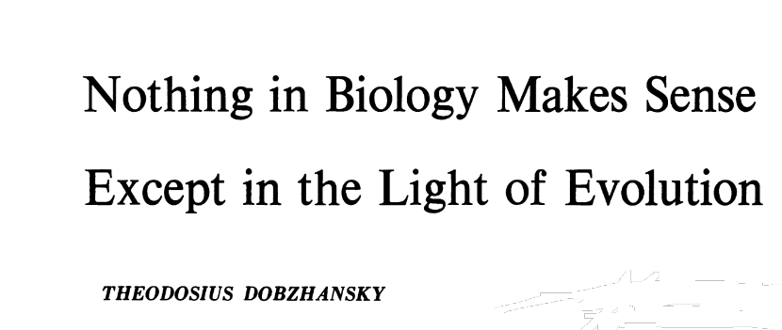
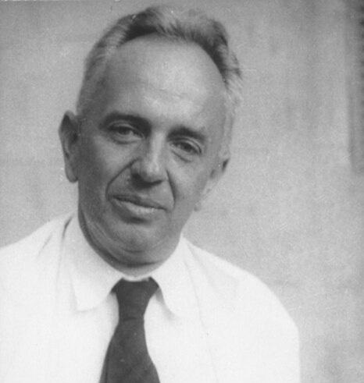
Some words about evolution
Link to essay
„Seen in the light of evolution, biology is, perhaps intellectually the most satisfying and inspiring science. Without that light it becomes a pile of sundry facts – some of them interesting or curious but making no meaningful picture as a whole.“
- T. Dobzhansky (1973)

Slide 3
Some words about evolution
Link to essay
What is evolution?
“The process by which new species or populations of living things develop from preexisting forms through successive generations” (Websters dictionary)

Slide 4
Origins of biodiversity
Biodiversity through geological time

Slide 5
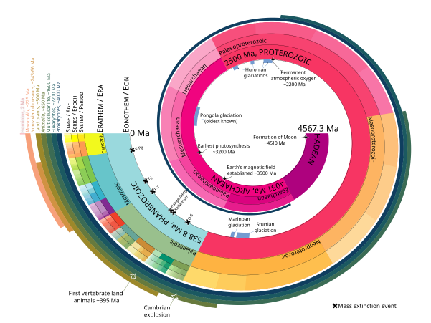
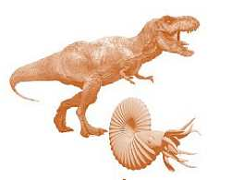
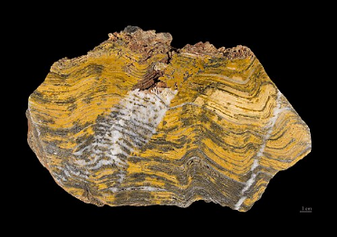
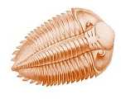
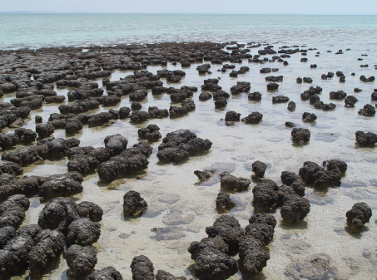
Biodiversity through geological time
When did it all begin?
Here!
Fossilized stromatolite in Western Australia, about 3.4 billion years old
Modern stromatolites
Paul Harrison CC BY-SA 3.0

Slide 6
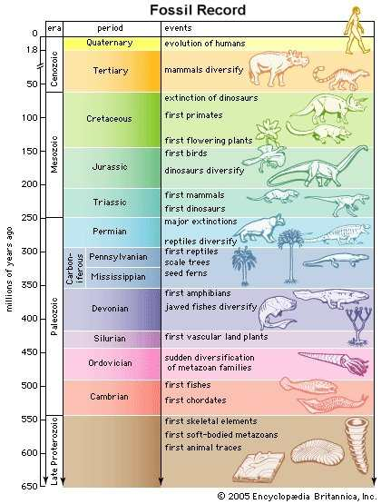
Biodiversity through geological time
When did it all begin?

Slide 7
How species disappear
Extinctions and mass extinctions

Slide 8
Extinction
What is extinction?
= the termination of a species; i.e., the dying out of all individuals that belong to a species
How can we define and compare extinctions?
Spatial:
Global extinctions vs. local- to regional-scale extirpations
Temporal:
Extinctions from the fossil record vs. recent historical extinctions
Length of the time interval to calculate extinction rates (past vs. present)
Other types:
species can become ecologically or functionally extinct before all individuals are dead
→ “dead clade walking“ or extinction debt: Not extinct yet, but will not recover
Example: abundances too low to form a viable population

Slide 9
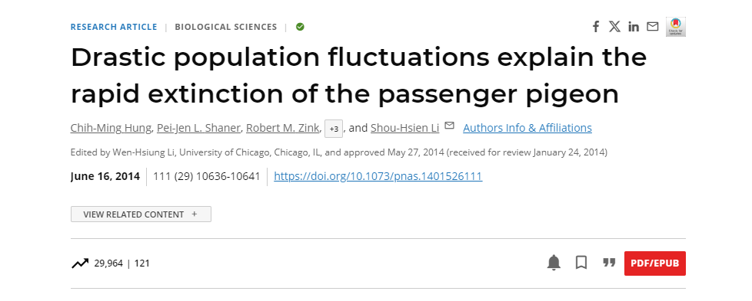
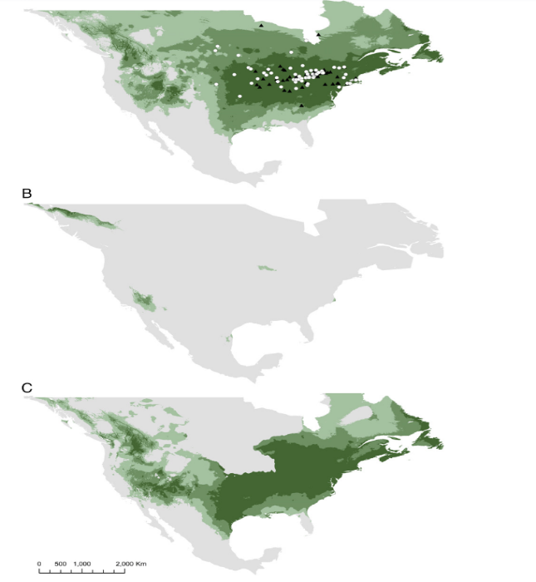
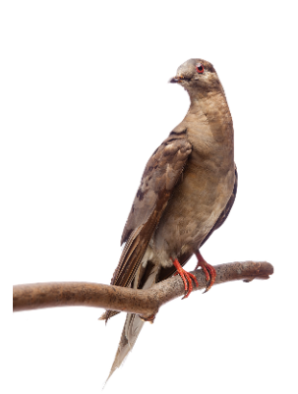
The passenger pigeon (Ectopistes migratorius) - the fast track to extinction
The most abundant bird in North America in the early 1800s (3-5 billion individuals)
Millions of individuals were hunted every year by the settlers for meat
The species was eradicated within a human life span (approx. 70 years)
Birds bred in massive colonies of billions of individuals, making them vulnerable to density-dependent regulatory factors (e.g., infectious diseases, overexploitation)
MARTHA
Last of her species, died 1914, age 29, in the Cincinnati Zoological Garden

Slide 10
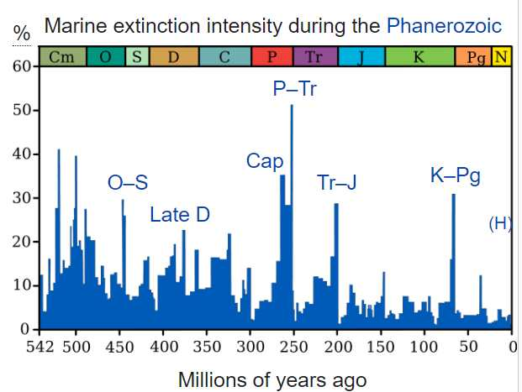
Mass Extinctions
The usual background rate is ca 0.1-1 per million species-year (for fossilizing organisms)
mass extinctions are much more extinction than usual
when both marine and terrestrial taxa considered, then it’s roughly 30-80% of extinct genera per big event
→ Mass extinction events mark geologic period changes

Slide 11
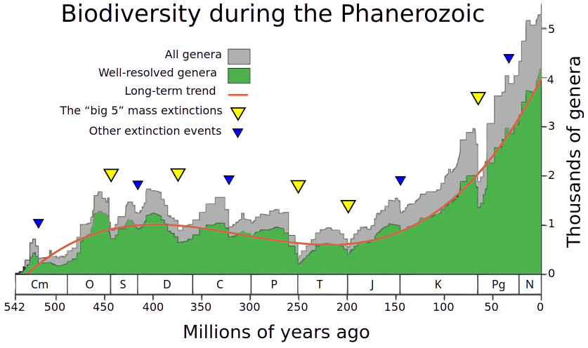
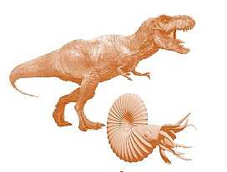
“The Big 5” Mass Extinctions: 1/5
(5)
Ordovician – Silurian extinction
Time: ~443 Mya
Impact: 85% of marine species extinct
Cause: Rapid cooling, extensive glaciation
(1)
(2)
(3)
(4)

Slide 12
“The Big 5” Mass Extinctions: 2/5
End-Devonian extinction
Time: 365 Mya
Impact: 40% of marine species extinct
Cause: Debated, maybe weathering (new land plants cause nutrient influx) and resulting anoxia
(5)
(1)
(2)
(3)
(4)

Slide 13
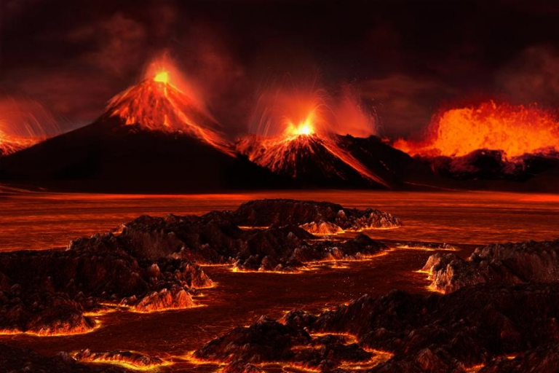
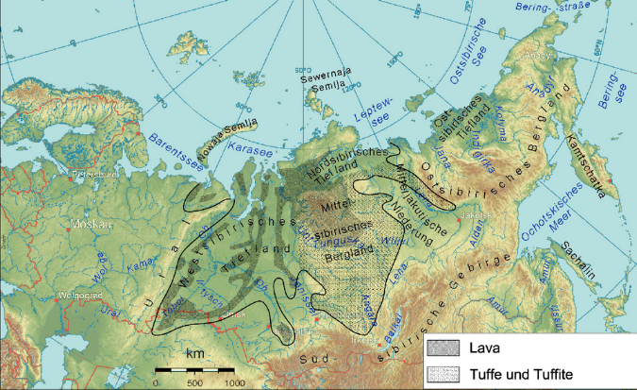
“The Big 5” Mass Extinctions: 3/5
Permian-Triassic extinction
Time: 250 Mya
Impact: 81% of marine & 70% terrestrial species extinct
Cause: Massive volcanism (Siberian Traps), methane release, anoxic and acidic oceans
José-Luis Olivares/MIT
(5)
(1)
(2)
(3)
(4)

Slide 14
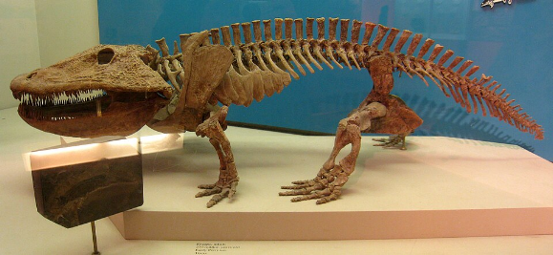
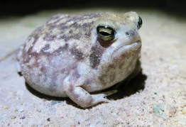
“The Big 5” Mass Extinctions: 4/5
End-Triassic extinction
Time: 200 Mya
Impact: 60%(?) of species extinct.
Loss of large-bodied amphibianser, plants and marine species
Cause: vulcanism & CO2
(5)
(1)
(2)
(3)
(4)

Slide 15
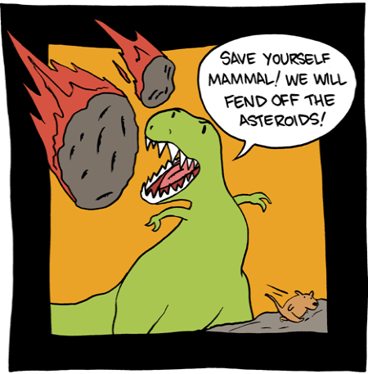
“The Big 5” Mass Extinctions: 5/5
Cretaceous-Paleogene extinction (K-T event)
Time: 66 Mya
Impact: 75% of species extinction.
Best known for extinction of non-avian dinosaurs
Cause: Asteroid impact (southern Mexico)
(5)
(1)
(2)
(3)
(4)

Slide 16
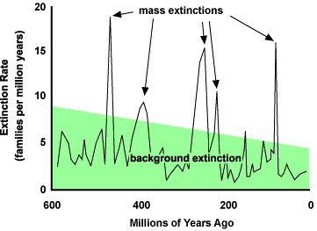
How does normal extinction look like: background extinction
How do we know it’s not just business-as-usual?
The background rate of extinction = the average extinction rate due to non-human causes over geological history
(approx. 1 E/MSY on average)
e.g., Mammal background rate = 2 mammal extinctions per 10,000 species per 100 years (that is, 2 E/MSY) (Ceballos, Ehrlich et al. 2015, SciAdv)

Slide 17
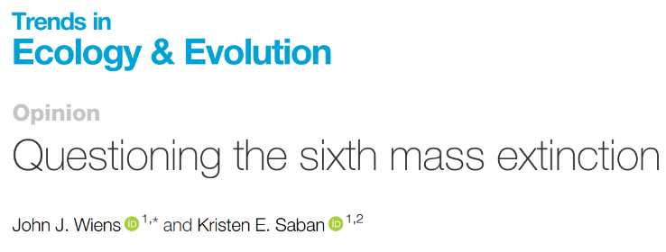
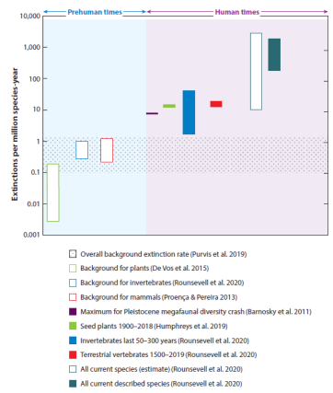
‘Sixth Mass Extinction’ – How do we know?
How do we know it’s not just business-as-usual?
https://doi.org/10.1016/j.tree.2025.01.002
Díaz & Malhi (2022) Annu. Rev. Environ. Res.

Slide 18
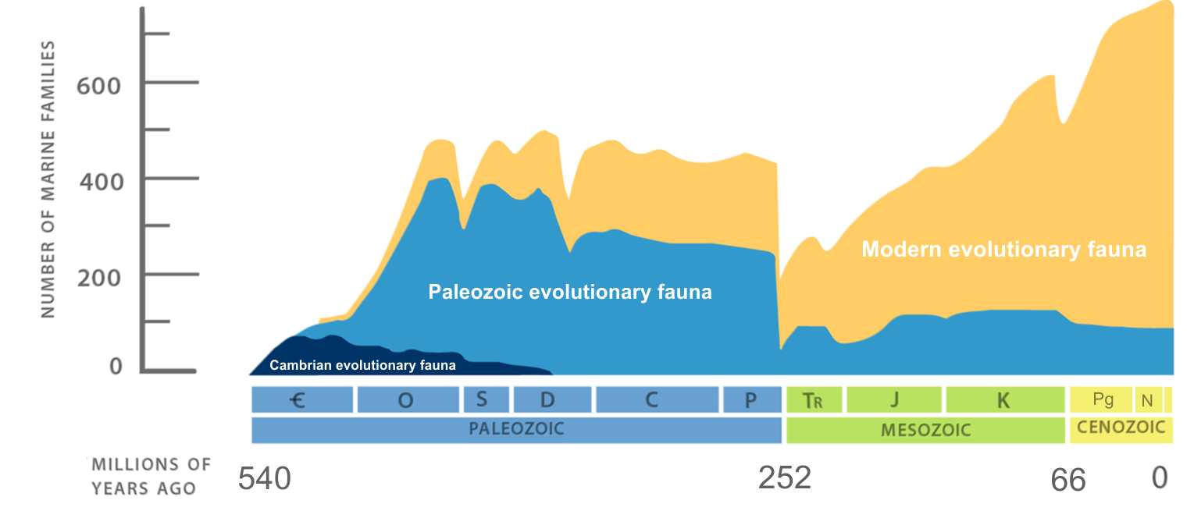
After a mass extinction event: biodiversity increases again

Slide 19
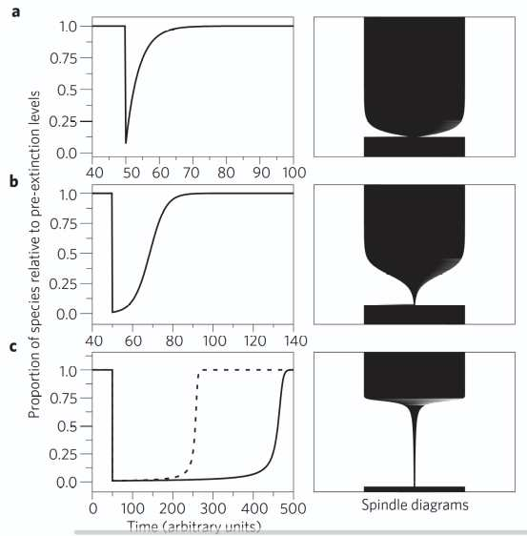
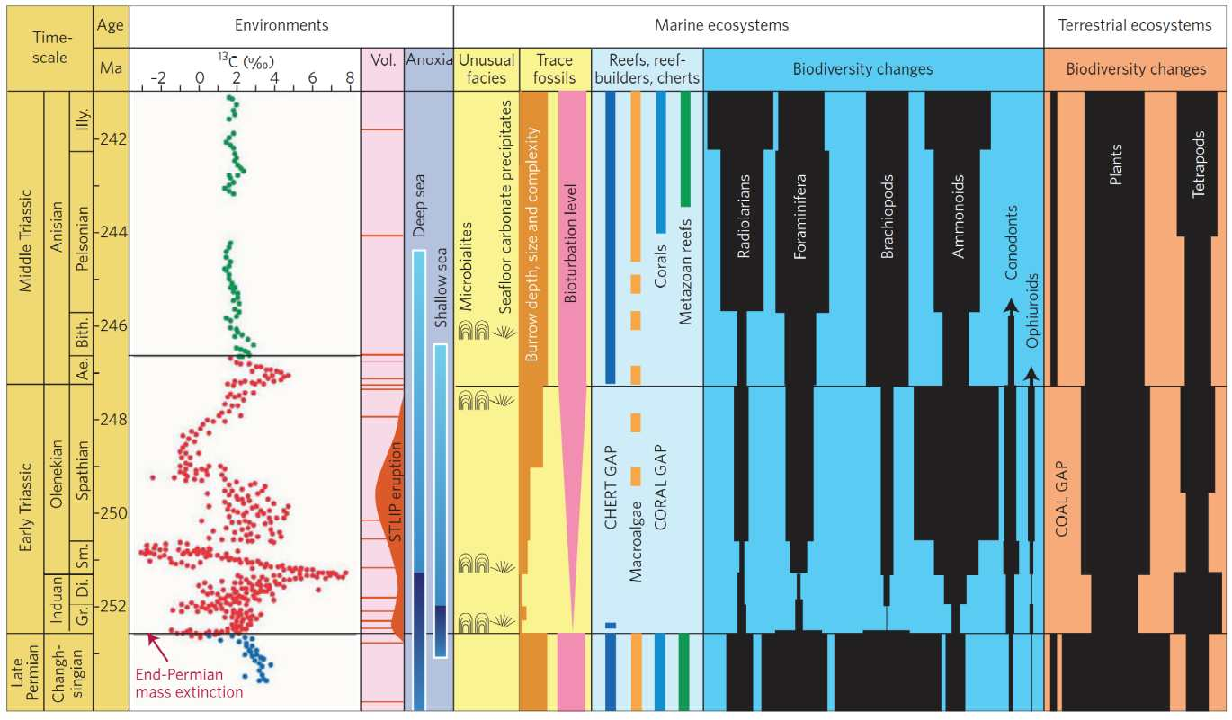
How does biodiversity recover from extinction? – Evolutionary perspective
Chen & Benton 2012, Nature Geoscience
Chen & Benton 2012, Nature Geoscience
Lineage through time (LTT) - plots

Slide 20
How new species emerge
Speciation

Slide 21
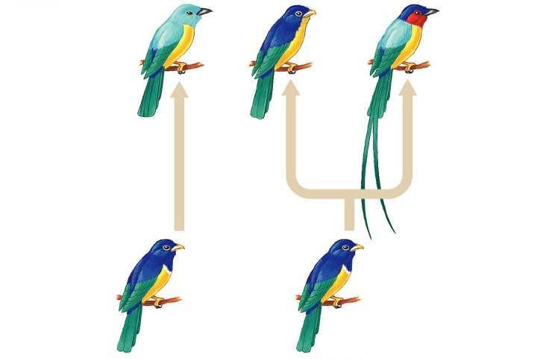
Speciation
What is speciation?
= the process by which new biological species arise
= the splitting of lineages (cladogenesis)
Anagenesis
Cladogenesis
non-branching process that transforms one ancestral species into a single descendant
splitting of an ancestral species into two or more daughter species

Slide 22
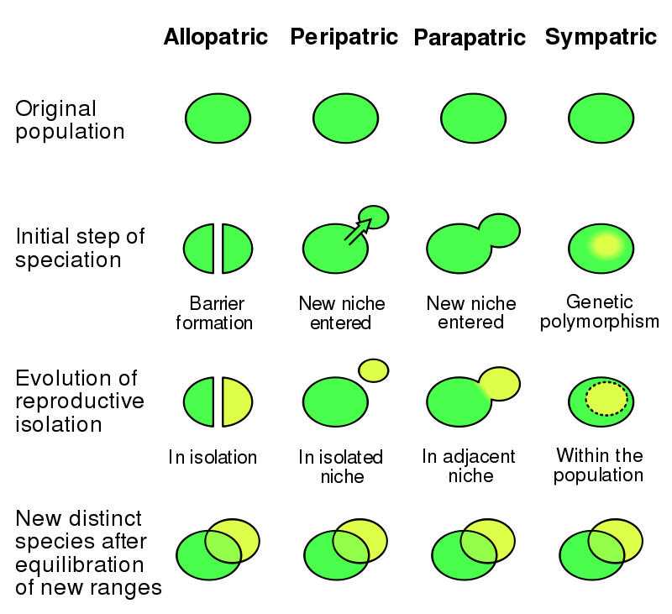
Modes of speciation
Allopatric speciation:
Most common speciation mode (probably)
This can only work when species change in time!
This happens through genetic drift (mutations), or adaptation to new environment

Slide 23
Modes of speciation
Sympatric speciation:
Speciation within spatially overlapping populations
Either due to disruptive selection (adaptation to two different environmental regimes) or chromosomal changes (e.g. polyploidy)
Pretty common in plants

Slide 24
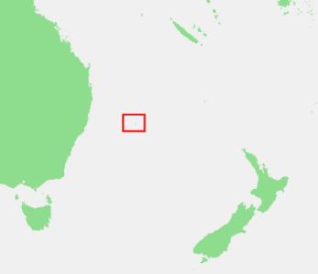
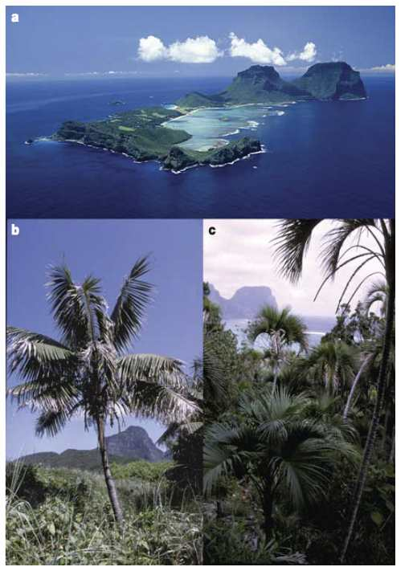
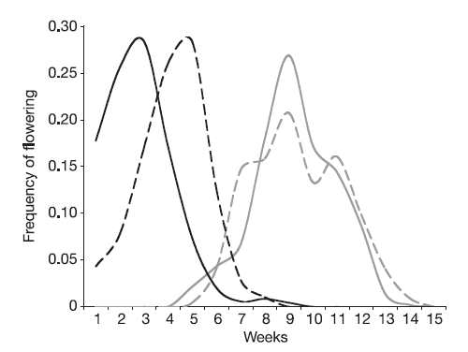
Example: Sympatric speciation of Howea palms
Sympatry: two palm species on Lord Howe Island
Sister relationship: phylogeny shows sister relationships and divergence after island formation
Reproductive isolation: different flowering time
Cause: Possibly disruptive selection (= adaptation to different soil types)
Howea forsteriana
Howea belmoreana
males (solid line) and female (dotted line)
Savolainen et al. 2006 Nature

Slide 25
How species change
Natural selection, adaptation and diversification

Slide 26
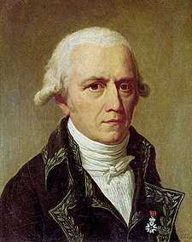
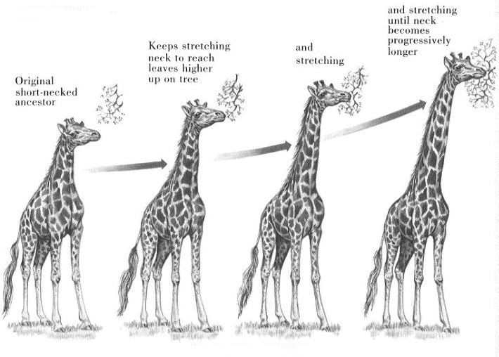
How species change: according to Lamarck
Jean-Baptiste Pierre Antoine de Monet, Chevalier de la Lamarck
(1744 – 1829)
The theory of species transformations
Not quite right, but acknowledging changes in species was a step in the right direction

Slide 27
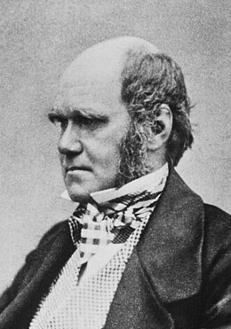
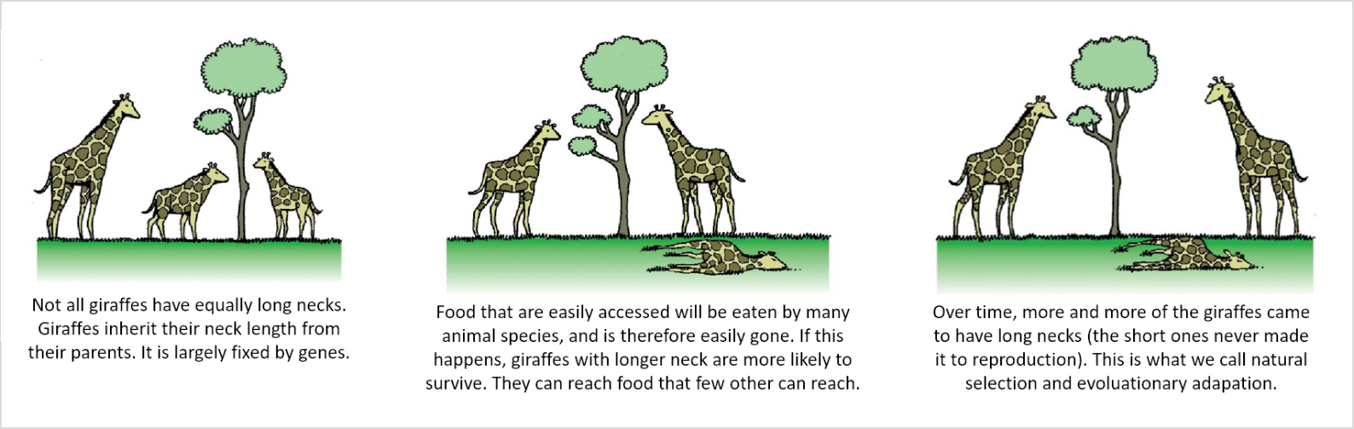
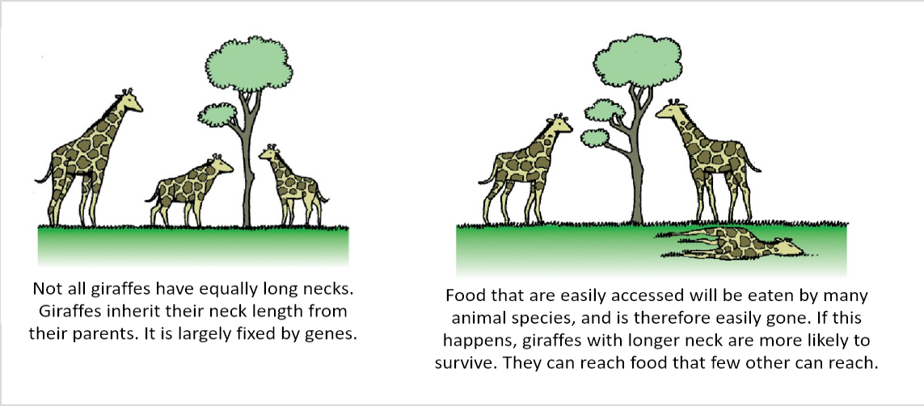
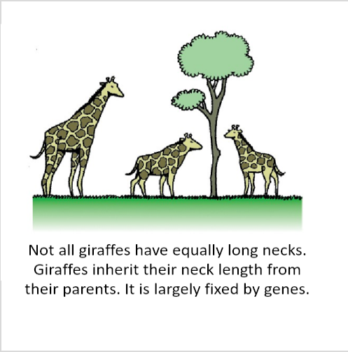
How species change: according to Darwin (natural selection)
Darwin (1859) On the Origin of Species
The theory of natural selection
Natural selection is passive (the environment selects) and
acts over generations

Slide 28
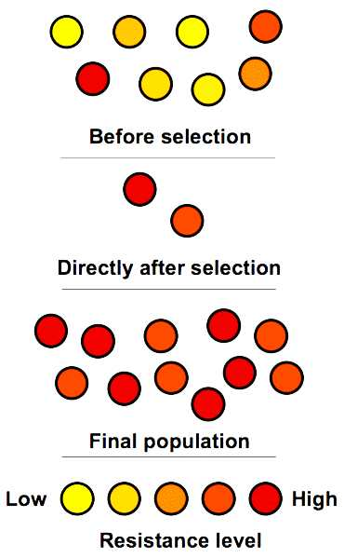
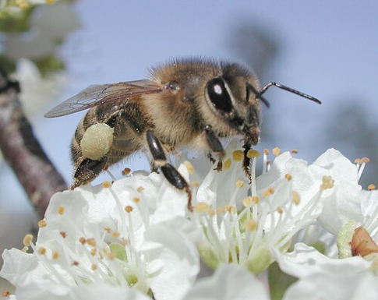
Adaptation
Adaptation
a feature (trait) produced by natural selection for its current function to enhance the fitness
Example: co-adaptation of pollinators and plants
Organisms do not adapt during their lifetime, they merely reproduce and die

Slide 29
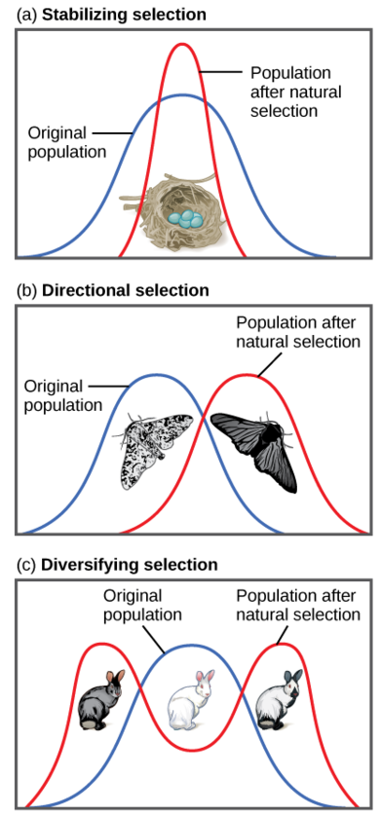
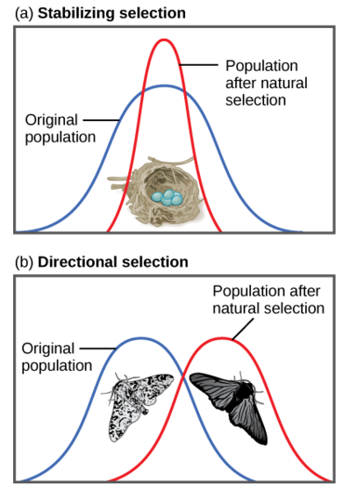
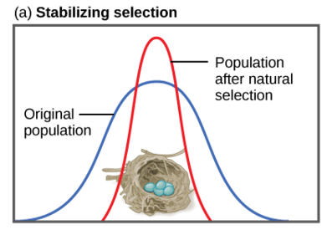
Types of natural selection: Examples
Stabilizing selection:
Robins typically lay four eggs
Larger clutches may result in malnourished chicks
Smaller clutches may result in no viable offspring
Directional selection:
Light-colored peppered moths are better camouflaged against a pristine environment
Dark-colored peppered moths are better camouflaged against sooty environment
As the industrial revolution progressed in 19th century England, the color of the moth population shifted from light to dark
Diversifying / Disruptive selection:
In a rocky environment, gray, and gray and white rabbits are better camouflaged than white rabbits in their natural habitat
Leads to diversification

Slide 30
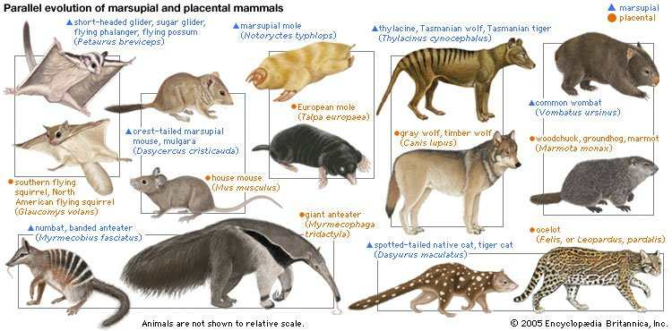
What supports the idea of evolution?
Evolution is a scientific theory, not a fact.
→ Facts are the data, theories interpret the data.
Hierarchical structure of similarity in nature.
The existence of homologies and parallel evolution.
Fossils.
Imprints in embryonal development.
Imperfect nature of some traits.
Non-random distribution of organisms and traits.
It can also be re-created by humans, either experimentally (on drosophila, bacteria, …), or by breeding

Slide 31
How to explore past life
The fossil record vs phylogenetic trees

Slide 32
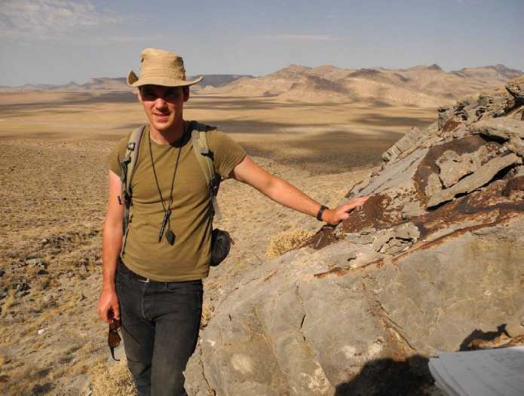
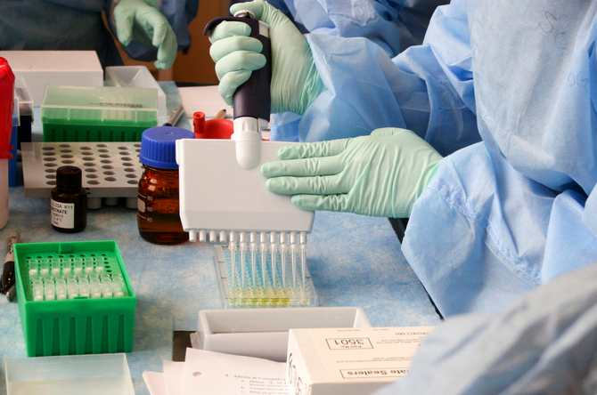
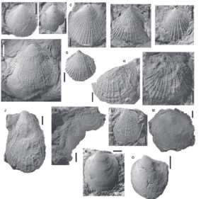
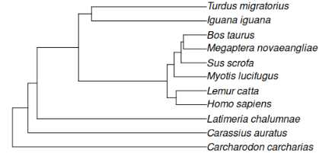
How did biodiversity look in the past, and how do we know?
 | The fossil record | <--> Phylogenies
Richard Hofmann
Public Health Image Library, Centers
for Disease Control and Prevention.
Hofmann et al. Palaeontology, 2014

Slide 33
How did biodiversity look in the past, and how do we know?
The fossil record | Phylogenies
Direct evidence: based on fossils Morphology Temporal ranges Geographic distribution (but plate tectonics!) Extinctions Behavioral clues: fossilized tracks, gut content | Indirect evidence: phylogenies are hypotheses about relatedness based on molecular or morphological data Measures of relatedness Divergence times Ancestral state reconstruction (e.g. morphology) Biogeographic patterns

Slide 34
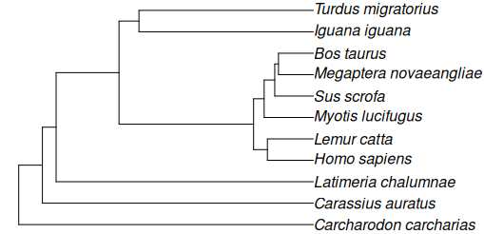
How did biodiversity look in the past, and how do we know?
The fossil record | Phylogenies
Direct evidence: based on fossils Morphology Temporal ranges Geographic distribution (but plate tectonics!) Extinctions Behavioral clues: fossilized tracks, gut content, reproduction | Indirect evidence: phylogenies are hypotheses about relatedness based on molecular or morphological data Measures of relatedness Divergence times Ancestral state reconstruction (e.g. morphology) Biogeographic patterns in relatedness
Dating?
They are complementary
→ phylogenies are dated with fossil calibration points:
Time?

Slide 35
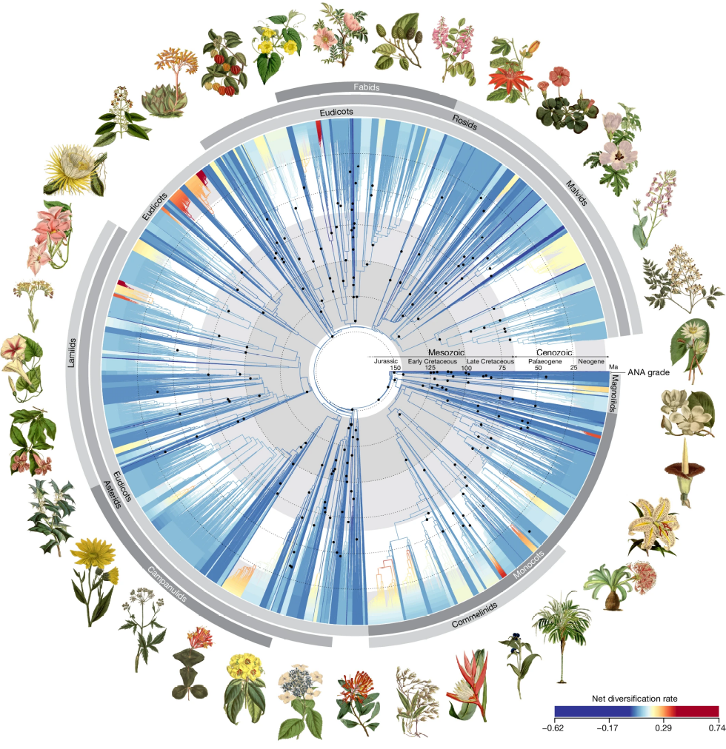
How did biodiversity look in the past, and how do we know?
Dating?
Time-calibrated phylogenetic tree for angiosperms
→ Black dots at nodes are fossil calibrations
Zutini et al. 2024 Nature

Slide 36
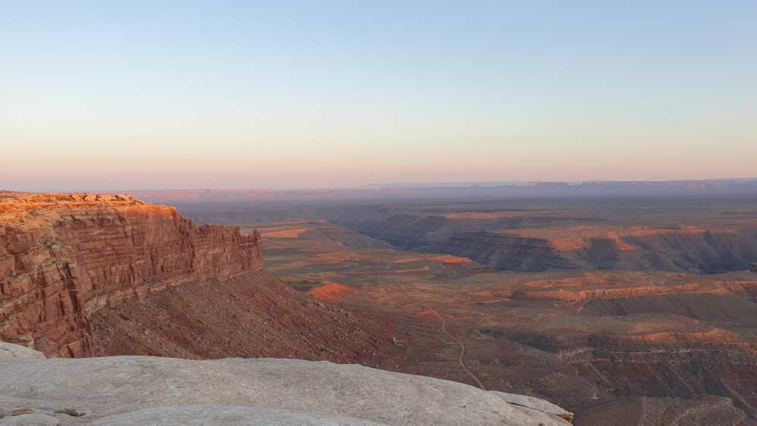
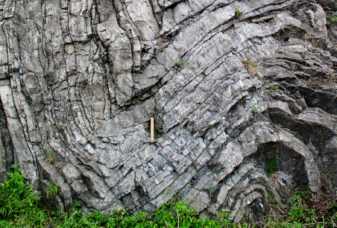
How to date the fossil record?
Dating?
Relative dating
Absolute dating
Stratigraphy | Fossils found in lower rock layers are older than those in higher layers: Law of Superposition
Biostratigraphy | Uses index fossils (high abundance, big range, but short-lived species) to correlate and date rock layers globally
young
old
Radiometric Dating | Measures the decay of radioactive isotopes
Carbon-14 (¹⁴C) | Used for organic remains (e.g. bone, wood) up to ~50,000 years
Cedar Mesa, Utah
na Barrandově skále v Praze, Devonian limestone

Slide 37


What to do with the fossil record?
The Paleobiology Database
https://paleobiodb.org/#/

Slide 38
Phylogeny
Evolutionary trees and how to read them

Slide 39
How to read a phylogeny
phylogenetic tree: a diagram that represents evolutionary relationships between taxa
Terminal Nodes or present-day taxa
Branches or
Lineages
A
B
Represent the
taxa
C
D
Ancestral Node
or root of
the tree
Internal Nodes or
Divergence Points (represent hypothetical ancestors of the taxa)
E

Slide 40

Types of phylogenetic trees
Cladogram
= only represents the branching-pattern, but is unscaled (branch lengths are not representative of anything)
Phylogram
= Branch lengths are proportional to the amount of character change (e.g., genetic distance)
Chronogram
= Branch lengths represent time
B
genetic distance (d)
6
Taxon B
A
1
1
Taxon C
3
C
1
Taxon A
5
Taxon D
D

Slide 41

How do we get a phylogeny?
We use homologous characters — characters in different organisms that are similar because they were inherited from a common ancestor that also had that character. An example of homologous characters is the four limbs of tetrapods. Birds, bats, mice, and crocodiles all have four limbs. Sharks and bony fish do not. The ancestor of tetrapods evolved four limbs, and its descendents have inherited that feature — so the presence of four limbs is a homology.
These can be morphological, or molecular.
evolution.berkeley.edu

Slide 42


Do not confuse homology with analogy
Bat wings consist of flaps of skin stretched between the bones of the fingers and arm. Bird wings consist of feathers extending all along the arm. These structural dissimilarities suggest that bird wings and bat wings were not inherited from a common ancestor with wings.
→ separate evolutionary origins, but same function
→ developed independently
evolution.berkeley.edu

Slide 43
What are phylogenies good for in ecology and conservation?

Slide 44

Phylogenetic endemism and evolutionary distinctness
Global patterns of phylogenetic endemism and congruence of phylogenetic endemism hotspots for tetrapods.
(A) Spatial and (B) latitudinal patterns of phylogenetic endemism (uncorrected for richness; red). (C) Spatial and (D) latitudinal patterns of phylogenetic endemism (corrected for richness; blue). Note that the values of phylogenetic endemism uncorrected for richness are log-transformed in graph (B), and the fitted line is from loess regression. (E) Congruence map of phylogenetic endemism hotspots.
Murali et al. (2021) Science Advances

Slide 45

Phylogenetic imputation
We can guess values of traits in species for which we have no information.
Examples:
- body size
- thermal requirements
- conservation threat status
Jetz & Freckleton (2015) Philos Trans R Soc B

Slide 46

Ancestral state reconstruction
Reconstruct the most likely ancestral state:
- morphology
- biogeographic origin
→ e.g. origins in tropics or temperate areas?
Phytools (Liam Revell)

Slide 47



Get diversification rates & map them
Jetz et al. (2012) Nature
BAMM (Bayesian analysis of macroevolutionary mixtures) example for whales
Igea & Tanentzap (2022) Ecology Letters

Slide 48





Zooming out: comparing with other biodiversity measures
Plants
Birds
Ants
Species
Richness
Diversification
rates
Tietje et al., 2022, PNAS: Global variation in diversification rate and species richness are unlinked in plants
Jetz et al., 2012, Nature: The global diversity of birds in space and time
Economo et al., 2018, Nature Comms: Macroecology and macroevolution of the latitudinal diversity gradient in ants

Slide 49

Phylogenetic comparative methods
Fig.1 Possible results when assessing the relationship between species traits and species environmental preferences. In the figure, each species is represented by one circle, with different colours indicating different clades. Solid lines show relationship between trait and environment without taking phylogeny into account. Dashed lines show relationships between trait and environment taking phylogeny into account (i.e. within clades). Ecological niche refers to species preferred environmental conditions.
De Bello et al. 2015 Folia Geobotanica

Slide 50


Phylogenetic scale
Graham et al. 2018 Global Ecology and Biogeography

Slide 51
The end

Slide 52
What you should remember
The number of taxa steadily increased through geological time
There have been 5 major extinction events (the “big five”) and we might be in the midst of another one
Apart from extinction, the other process generating biodiversity is speciation
You should know the principle of Darwinian natural selection, and how it’s connected to speciation
Evolutionary relationships among organisms are represented by a phylogeny a.k.a. phylogenetic tree

